Slide 1
My app

Slide 2
User stories
A new truck driver can sign up for an app
A truck driver can input his/her route
A truck driver can add notification that he/she needs help (flat tire etc.)- will be visible on the map
A truck driver can message any other truck driver on the app
*Map contains all of the routes and current locations of the drivers who have their location on. Also, when you click on the certain route it shows you the profile of the driver whose route it is.

Slide 3
Story 1
“A new truck driver can sign up for an app”
A truck driver can sign up for an app by choosing username and a password.
When he/she signs up for an app the first page is the map page, where all of the routes are visible.

Slide 4
Story 2
“A truck driver can input his/her route”
A truck driver logs into the app.
When he/she logs in the first page is map page and there is an option to input route.
When user clicks on input route, it redirects to the new page where he/she can choose starting point and endpoint.
After that this route is also visible on the map.

Slide 5
Story 3
“A truck driver can add notification that he/she needs help “
A truck driver logs into the app.
When he/she logs into the app the first page is the map page, where all of the routes are visible.
By clicking on the notification icon it redirects the user to the page, where they can input what kind of problem they are having.
After this their route becomes red and there is a sign that notifies other users that this user needs help.
*Note that for the option to have an emergency button used, user has to input his/her route first.

Slide 6
Story 4
“A truck driver can message any other truck driver on the app”
A truck driver logs into the app.
When he/she logs into the app the first page is the map page, where all of the routes are visible.
By clicking on a route, user can see whose route that is-it redirects him/her to the profile page of the user.
On the profile page of any user there is a chat option.
Also, note that users can access their previous chats easily from the map page.

Slide 7
SIGN UP
Username:
john_mercedez
Password:
******

Slide 8
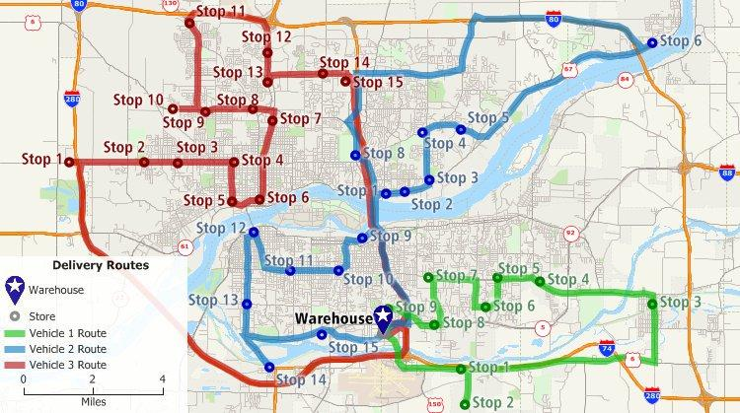

Slide 9
Choose starting point:
Kragujevac, Serbia
Choose destination:
Hamburg, Germany

Slide 10
CHATS
John: I am on my way!
Peter: Almost there.
Soph: See you tm.

